Slide 1


EXPENSE
TRACKER
CREATED BY-
Rohan Saini
(181332)
Harshit Kumar Gupta
(181334)
Project Supervisor:
Dr. Aman Sharma

Slide 2
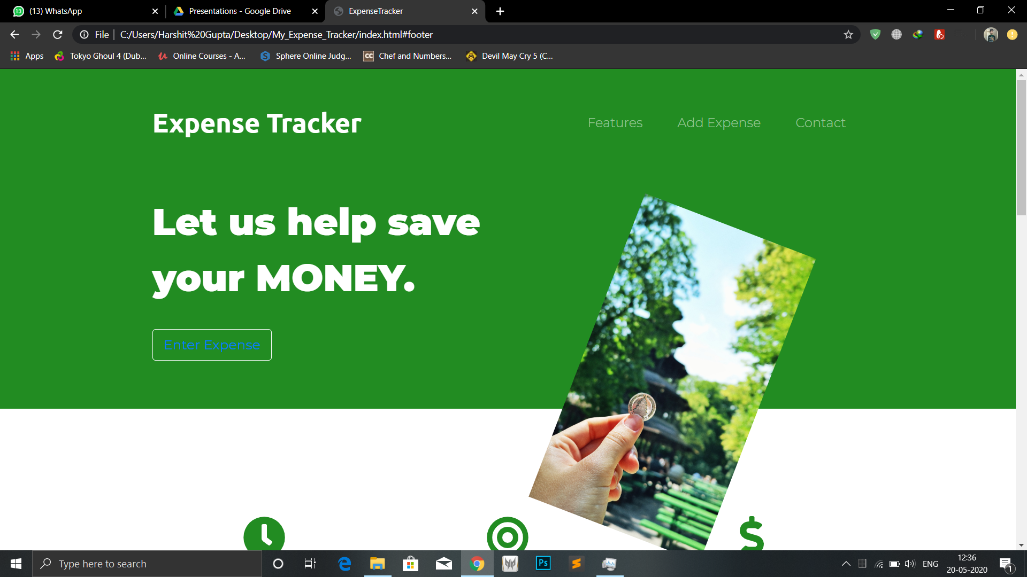
Screenshot 1
INTRODUCTION
Expense Tracker is a website where users can
Maintain a record of their expenditure.
LET US HELP SAVE YOUR MONEY!
03
01
02
Save Money.
Acquire Goal
Save Time
Organize your income, easily track expenses with a single click and much more. We are always happy to help you save more and more.
Having trouble saving money? we have plans to get your dreams come true. Help us save your money and have to power to purchase your dreams.
Find total record of your expenditure at one place, no more maintianing vintage notebooks now.

Slide 3
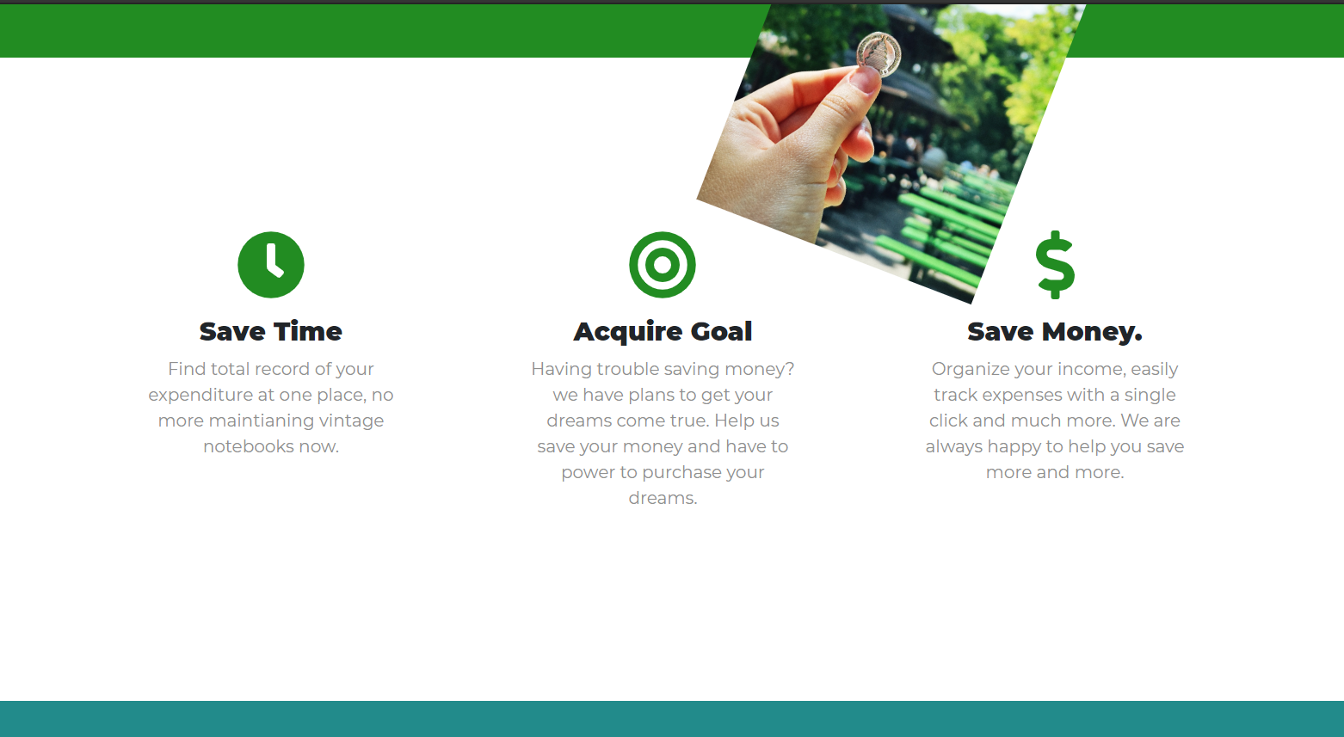
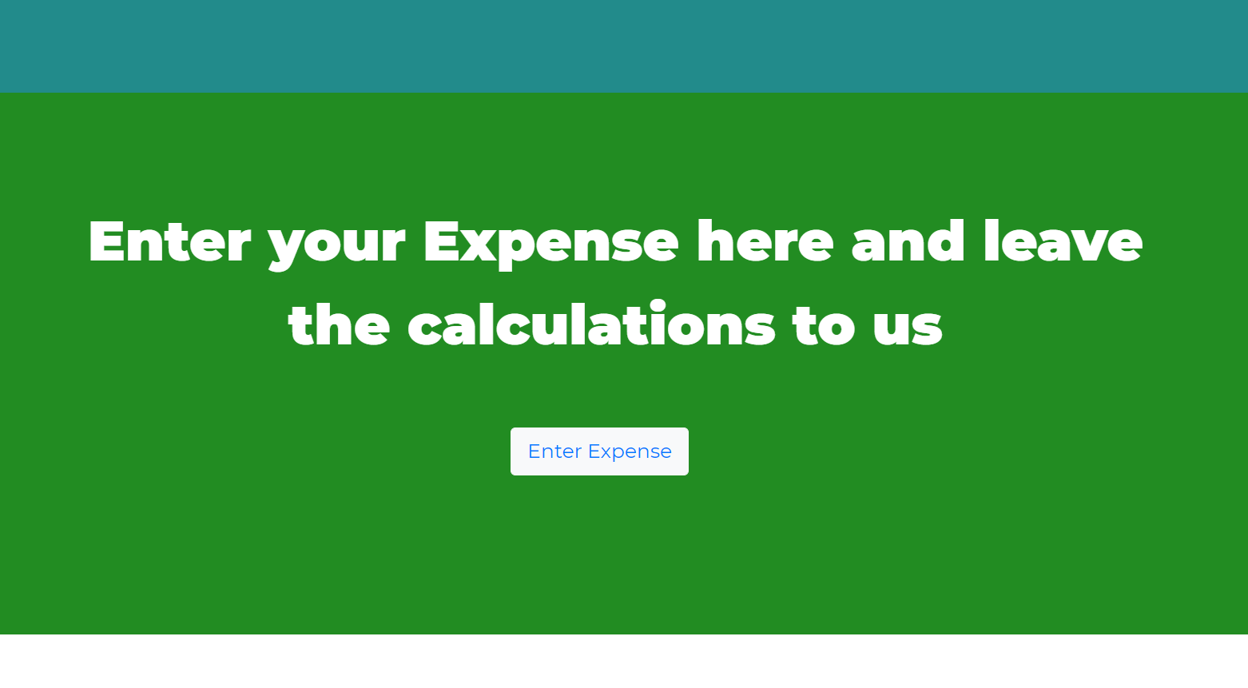
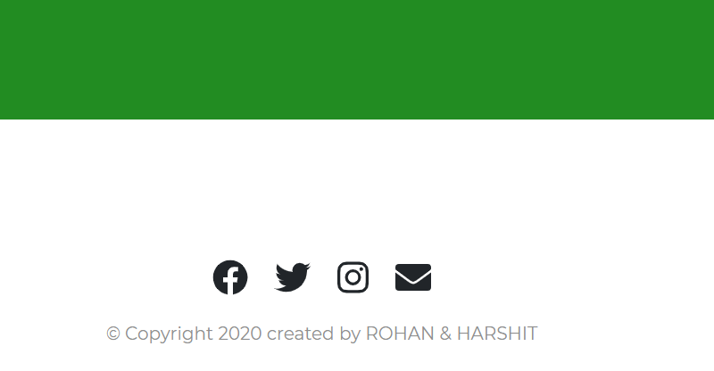
01
INTRODUCTION
Come and explore the benefits of saving money, know a little more about our Expense Tracker Website
02
ADD AN EXPENSE
Some Features
(screenshots)
This buttons had a hyperlink which connects it to another webpage where user enters expenses.
03
CONTACT US
Find our contact details at the bottom of our website.

Slide 4
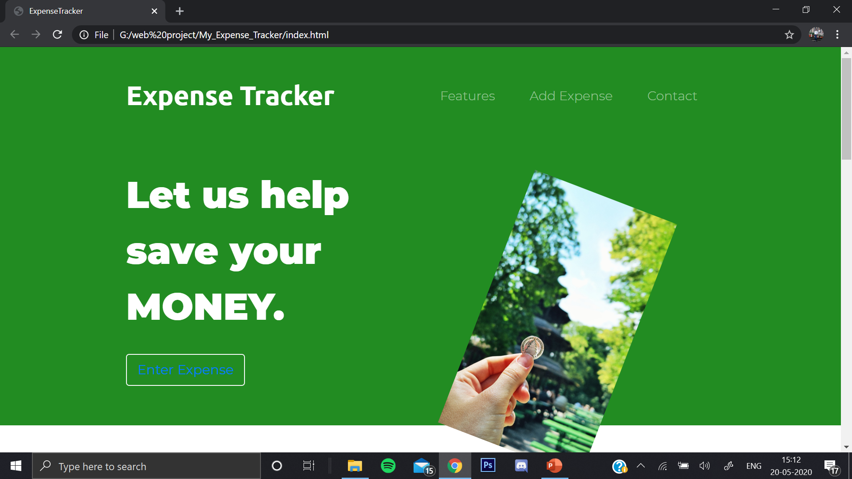
HOME PAGE
Features of
HOME PAGE
It has Anchors
-Features
-Add Expense
-Contact
Enter Expense
is a hyperlink which
opens the Expense sheet
(another webpage)
- Simple Design
screenshot

Slide 5

WHY our WEBSITE?
screenshot
Know a little more about the Benefits.

Slide 6

Quotes Carousel
screenshot
Famous Quotes about Saving Money keep moving here.

Slide 7
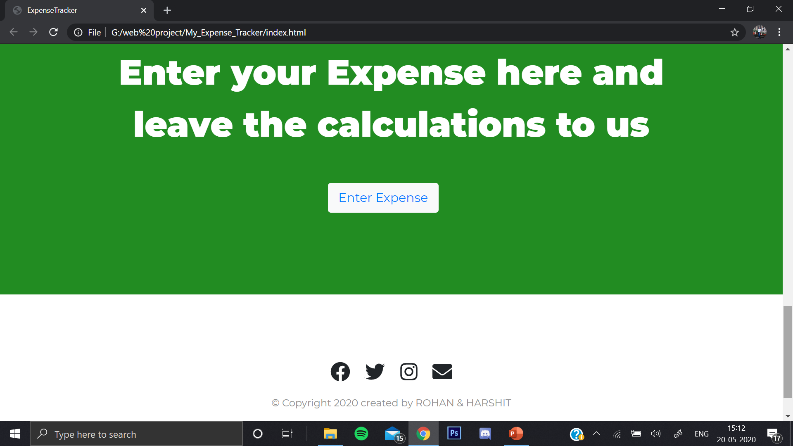
ENTER EXPENSE
screenshot
Contact Us section at the bottom of the website.
Click this Button to Enter Expense.
(hyperlink to Expense Sheet)

Slide 8
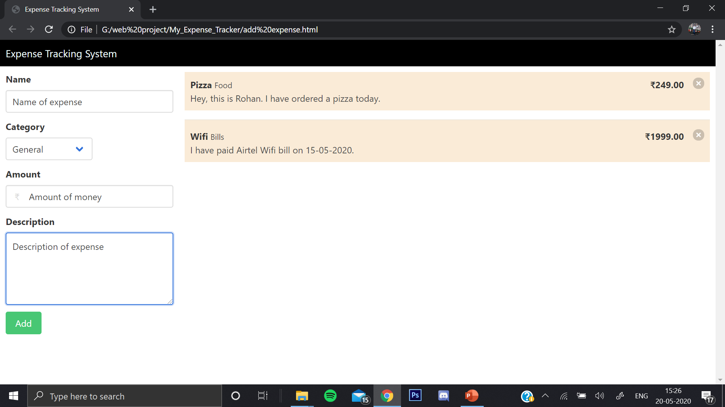
The ADD EXPENSE Link directs here:
Here you can add, Delete and customize your expenses.
Category section has a drop down menu.
Gives an error when an invalid Amount is entered.
Fill a simple form to add an expense.
Click on cross to delete an entry.

Slide 9
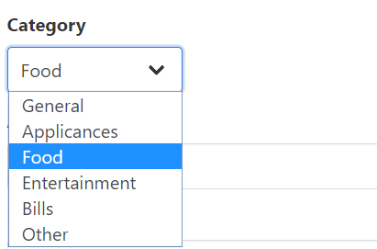
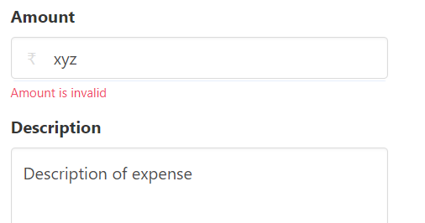
Features of EXPENSE SHEET (webpage)
Typing non numerical values in Amount input Generates Error.
(screenshots)
It has a drop down menu to facilitate users, it provide the above mentioned options.

Slide 10
Hope you like our Expense Tracker Website.
THANK YOU
ROHAN SAINI ( 181332 )
HARSHIT KUMAR GUPTA ( 181334 )

